Slide 1
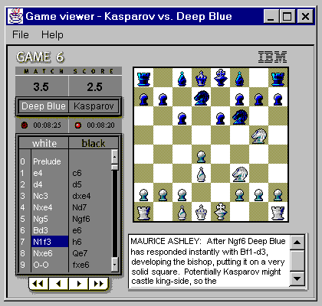
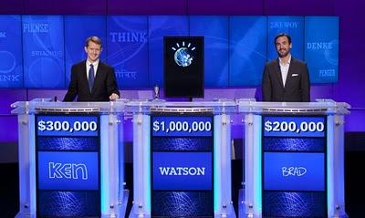
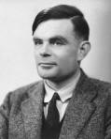
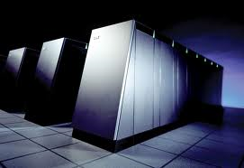
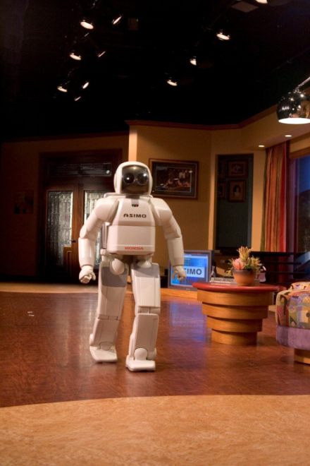
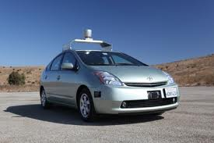
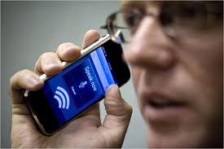
COSC 473/573: Artificial Intelligence
Notes:
<number>

Slide 2
Today
Course overview
What is AI?
Examples of AI today
Notes:
<number>

Slide 3
Who is this course for?
An introductory survey of AI techniques for students who have not previously had an exposure to this subject
Juniors, seniors, beginning graduate students
Prerequisites: solid programming skills, algorithms, calculus
Exposure to linear algebra and probability a plus
Credit: 3 units
Notes:
<number>

Slide 4
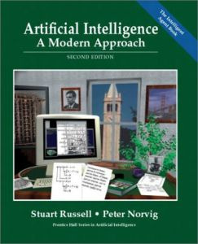
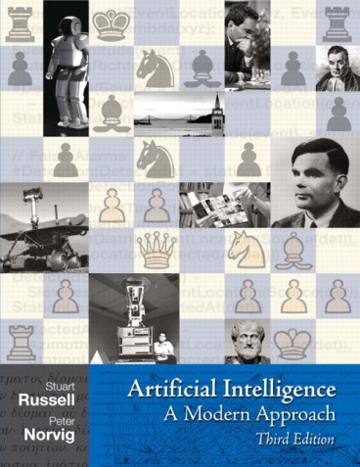
Basic Info
Textbook: S. Russell and P. Norvig, Artificial Intelligence: A Modern Approach, Prentice Hall, 2nd or 3rd ed. http://aima.cs.berkeley.edu/
Notes:
<number>

Slide 5
Course Requirements
Participation: 5%
Come to class!
Ask questions
Answer questions
Participate in discussions
Assignments: 45%
Written and programming
Individual and group
Programming assignments: you can use whatever language you wish.
Midterm/final: 50%
No book, no notes, no calculator, no collaboration
Mainly straightforward questions testing comprehension
Notes:
<number>

Slide 6
Academic integrity policy
Feel free to discuss assignments with each other, but coding and reports must be done individually
Feel free to incorporate code or tips you find on the Web, provided you understand every bit of it and you explicitly acknowledge your sources
Remember: I can Google as well as you can
Notes:
<number>

Slide 7
What is AI?
Some possible definitions from the textbook:
Thinking humanly
Acting humanly
Thinking rationally
Acting rationally
Notes:
<number>

Slide 8
Thinking humanly
Cognitive science: the brain as an information processing machine
Requires scientific theories of how the brain works
How to understand cognition as a computational process?
Introspection: try to think about how we think
Predict and test behavior of human subjects
Image the brain, examine neurological data
The latter two methodologies are the domains of cognitive science and cognitive neuroscience
Notes:
<number>

Slide 9
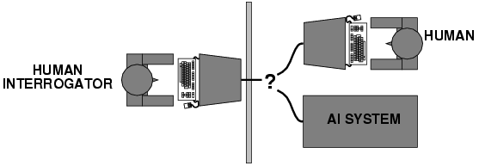
Acting humanly
Turing (1950) "Computing machinery and intelligence"
The Turing Test
What capabilities would a computer need to have to pass the Turing Test?
Natural language processing
Knowledge representation
Automated reasoning
Machine learning
Turing predicted that by the year 2000, machines would be able to fool 30% of human judges for five minutes
Notes:
<number>

Slide 10
Turing Test: Criticism
What are some potential problems with the Turing Test?
Some human behavior is not intelligent
Some intelligent behavior may not be human
Human observers may be easy to fool
A lot depends on expectations
Anthropomorphic fallacy
Chatbots, e.g., ELIZA
Chinese room argument: one may simulate intelligence without having true intelligence (more of a philosophical objection)
Is passing the Turing test a good scientific goal?
Not a good way to solve practical problems
Can create intelligent agents without trying to imitate humans
Notes:
<number>

Slide 11
Thinking rationally
Idealized or “right” way of thinking
Logic: patterns of argument that always yield correct conclusions when supplied with correct premises
“Socrates is a man; all men are mortal; therefore Socrates is mortal.”
Beginning with Aristotle, philosophers and mathematicians have attempted to formalize the rules of logical thought
Logicist approach to AI: describe problem in formal logical notation and apply general deduction procedures to solve it
Problems with the logicist approach
Computational complexity of finding the solution
Describing real-world problems and knowledge in logical notation
A lot of intelligent or “rational” behavior has nothing to do with logic
Notes:
<number>

Slide 12
Acting rationally: Rational agent
A rational agent is one that acts to achieve the best expected outcome
Goals are application-dependent and are expressed in terms of the utility of outcomes
Being rational means maximizing your expected utility
In practice, utility optimization is subject to the agent’s computational constraints (bounded rationality or bounded optimality)
This definition of rationality only concerns the decisions/actions that are made, not the cognitive process behind them
Notes:
<number>

Slide 13
Acting rationally: Rational agent
Advantages of the “utility maximization” formulation
Generality: goes beyond explicit reasoning, and even human cognition altogether
Practicality: can be adapted to many real-world problems
Amenable to good scientific and engineering methodology
Avoids philosophy and psychology
Any disadvantages?
Notes:
<number>

Slide 14
AI Connections
Philosophy logic, methods of reasoning, mind vs. matter, foundations of learning and knowledge
Mathematics logic, probability, optimization
Economics utility, decision theory
Neuroscience biological basis of intelligence
Cognitive science computational models of human intelligence
Linguistics rules of language, language acquisition
Machine learning design of systems that use experience to improve performance
Control theory design of dynamical systems that use a controller to achieve desired behavior
Computer engineering, mechanical engineering, robotics, …
Notes:
<number>

Slide 15
What are some examples of AI today?
Notes:
<number>

Slide 16
IBM Watson
http://www.research.ibm.com/deepqa/
NY Times article
Trivia demo
YouTube video
IBM Watson wins on Jeopardy (February 2011)
Notes:
<number>

Slide 17
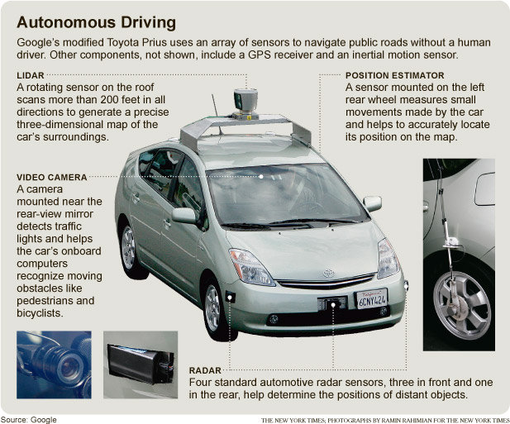
Google self-driving cars
NY Times article
Video
Notes:
<number>

Slide 18
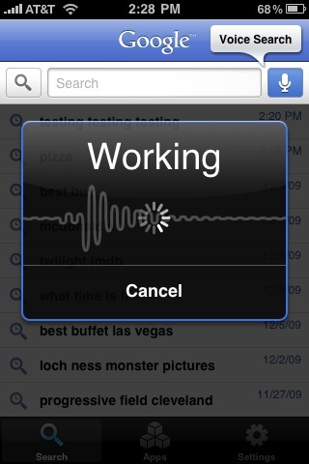
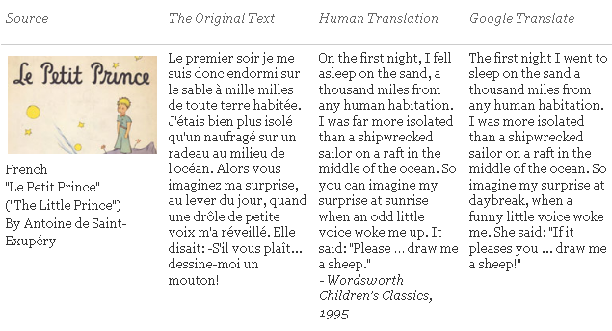
Natural Language
Speech technologies
Automatic speech recognition
Google voice search
Text-to-speech synthesis
Dialog systems
Machine translation
translate.google.com
Comparison of several translation systems
Notes:
<number>

Slide 19
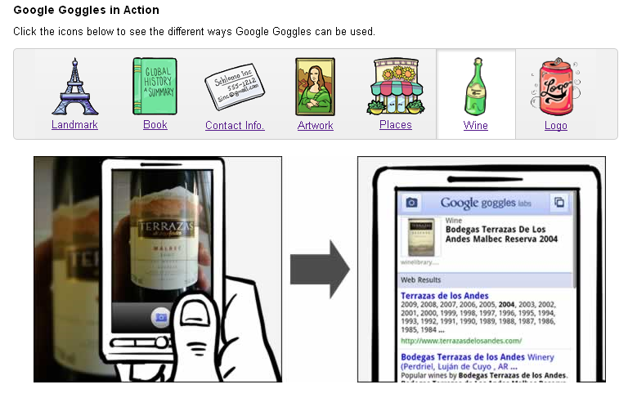
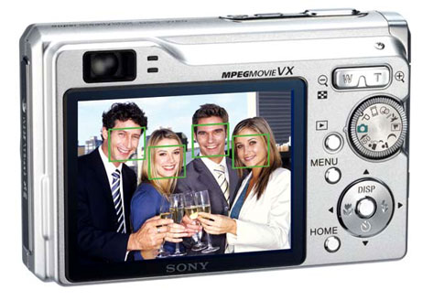


Vision
OCR, handwriting recognition
Face detection/recognition: many consumer cameras, Apple iPhoto
Visual search: Google Goggles
Vehicle safety systems: Mobileye
Notes:
<number>

Slide 20
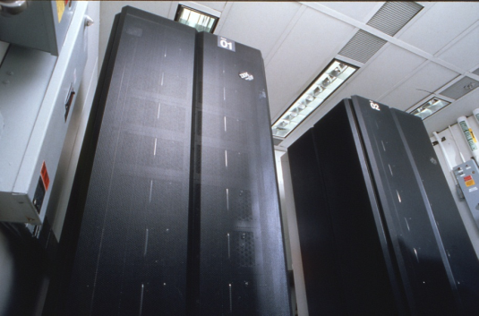
Math, games, puzzles
In 1996, a computer program written by researchers at Argonne National Laboratory proved a mathematical conjecture (Robbins conjecture) unsolved for decades
NY Times story: “[The proof] would have been called creative if a human had thought of it”
IBM’s Deep Blue defeated the reigning world chess champion Garry Kasparov in 1997
1996: Kasparov Beats Deep Blue “I could feel --- I could smell --- a new kind of intelligence across the table.”
1997: Deep Blue Beats Kasparov “Deep Blue hasn't proven anything.”
In 2007, checkers was “solved” --- a computer system that never loses was developed
Science article
Notes:
<number>

Slide 21
Logistics, scheduling, planning
During the 1991 Gulf War, US forces deployed an AI logistics planning and scheduling program that involved up to 50,000 vehicles, cargo, and people
NASA’s Remote Agent software operated the Deep Space 1 spacecraft during two experiments in May 1999
In 2004, NASA introduced the MAPGEN system to plan the daily operations for the Mars Exploration Rovers
Notes:
<number>

Slide 22
Information agents
Search engines
Recommendation systems
Spam filtering
Automated helpdesks
Medical diagnosis systems
Fraud detection
Automated trading
Notes:
<number>

Slide 23
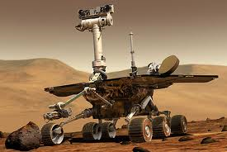
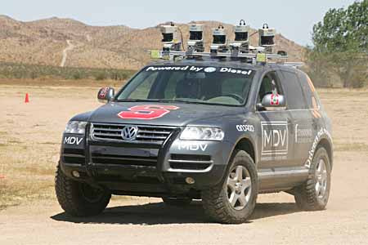

Robotics
Mars rovers
Autonomous vehicles
DARPA Grand Challenge
Google self-driving cars
Autonomous helicopters
Robot soccer
RoboCup
Personal robotics
Humanoid robots
Robotic pets
Personal assistants?
Notes:
<number>

Slide 24
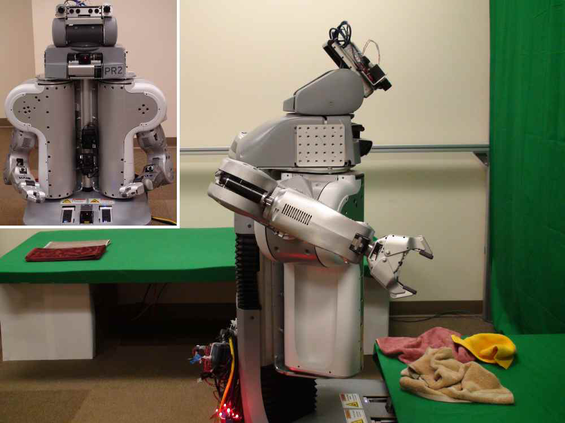
Towel-folding robot
J. Maitin-Shepard, M. Cusumano-Towner, J. Lei and P. Abbeel, “Cloth Grasp Point Detection based on Multiple-View Geometric Cues with Application to Robotic Towel Folding,” ICRA 2010
Notes:
<number>

